Slide 1
Predicting Readmission of Hospital Patients
Hemant Rattey

Slide 2
Agenda
Problem Statement
Splitting data into Training, Validation and Test sets
Exploratory Data Analysis
Data Preprocessing and Feature Engineering
Building Baseline Models
Feature Selection and Model Fitting
Hyperparameter Tuning
Final Evaluations and Conclusions

Slide 3
Problem Statement
Readmission of patients following discharge from hospital places an enormous and very expensive burden on the US healthcare system.
For this course project, we are predicting whether a patient will be readmitted within 30 days of discharge or not given some data about their encounters.

Slide 4
Splitting data into Training, Validation and Test sets
It is best practice to keep the test data for final evaluation of the model. That is why creating a validation set is important.
Splitting the training data into 15% of random validation data.
Keeping the test data for the final evaluation of the models.

Slide 5
Data Description
Each row in the dataset corresponds to an encounter for a patient.
The dataset has 50 features, some of which are categorical and some of which are numerical.
The “readmitted” column is the class label. Initially, there are 3 classes namely “No” (no readmission), “>30”(readmission after 30 days) and “<30” (readmission within 30 days).
The instances with “<30” in readmitted column will be treated as the positive class and rest will be treated as negative class thus representing a binary classification problem.

Slide 6
Exploratory Data Analysis
For categorical columns in the data, a bar plot for the frequency distribution of unique values in the data along with the bar plot against the class label “readmitted” are plotted.
Not all categorical columns are considered for plotting.
For numerical columns “num_lab_procedures” and “num_medications”, a histogram is plotted along with the mean line for that attribute.

Slide 7
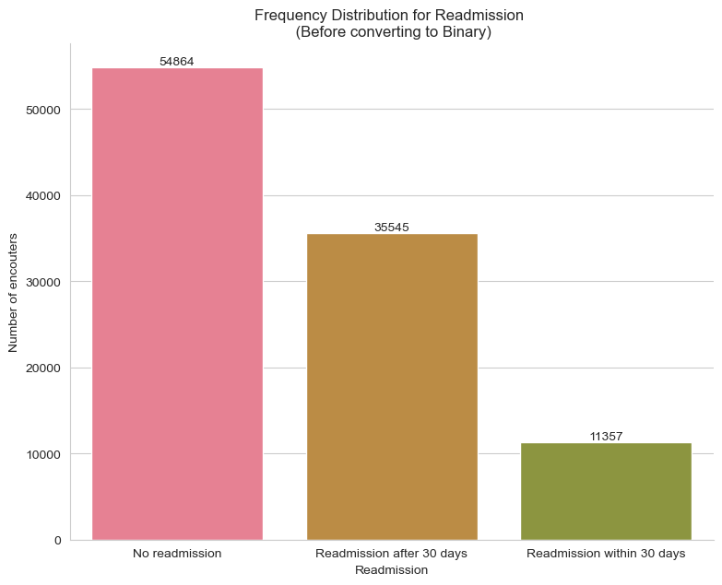
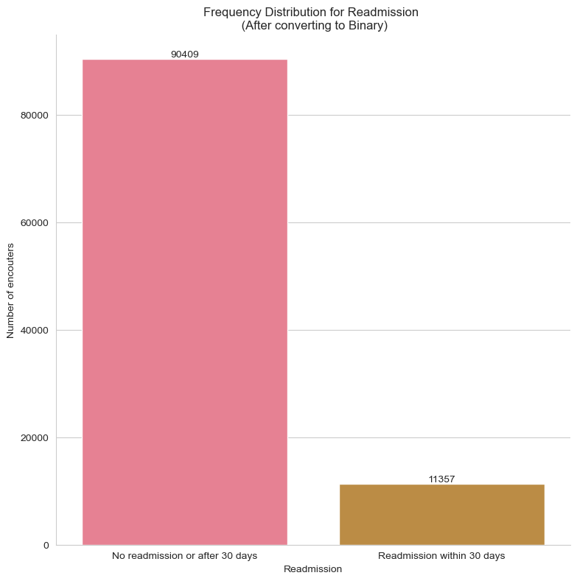
Bar Plot for Readmitted Class Label
Original Class Labels
Updated Binary Class Labels

Slide 8
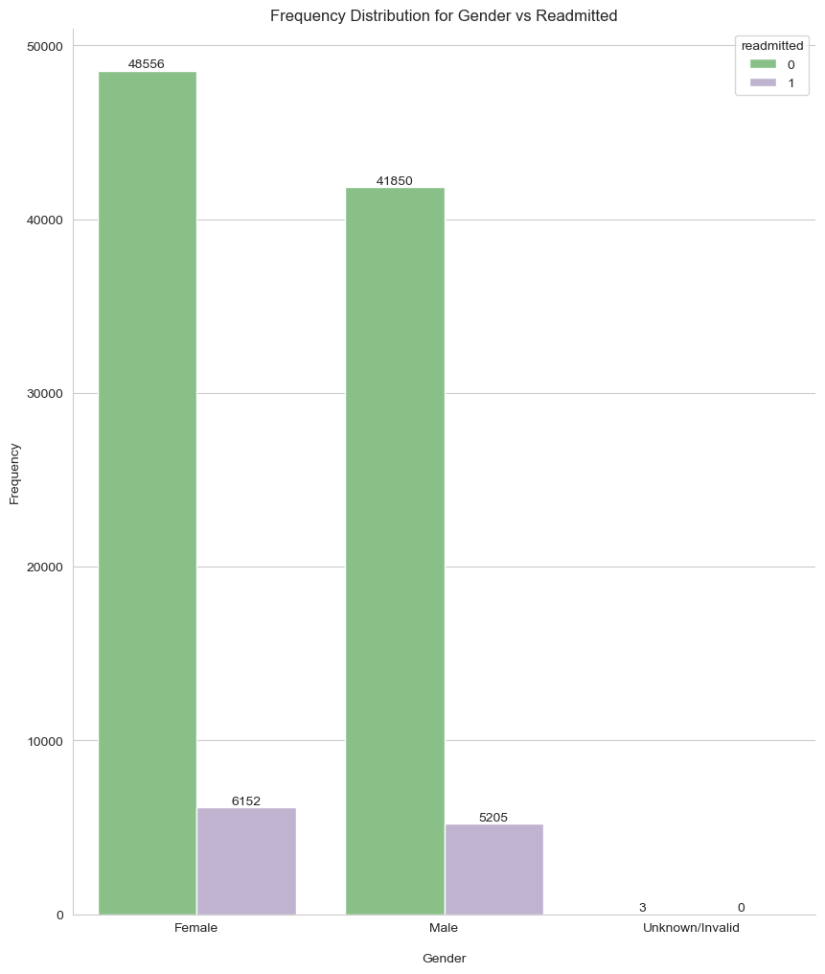
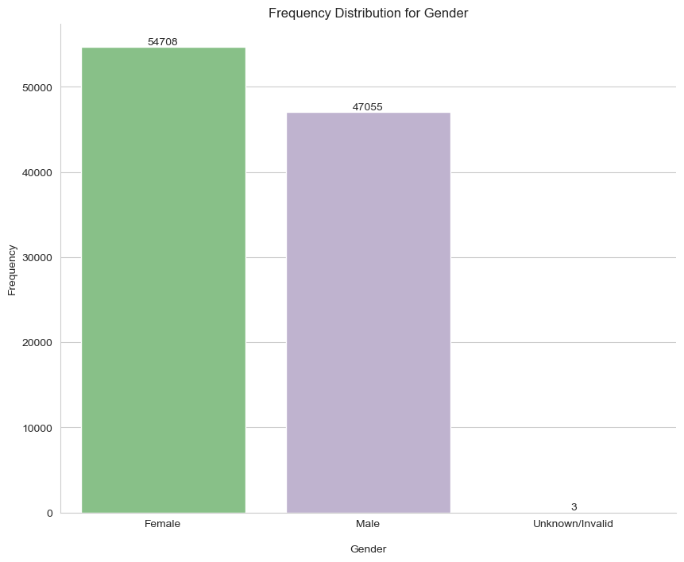
Exploring Gender Feature
The genders are approximately equally balanced with only a ~7000 difference between Female and Male patients, respectively. Additionally, the genders grouped by readmission are also more or less equally balanced. There are 3 Unknown/Invalid genders which will be dropped later in the cleaning process.

Slide 9
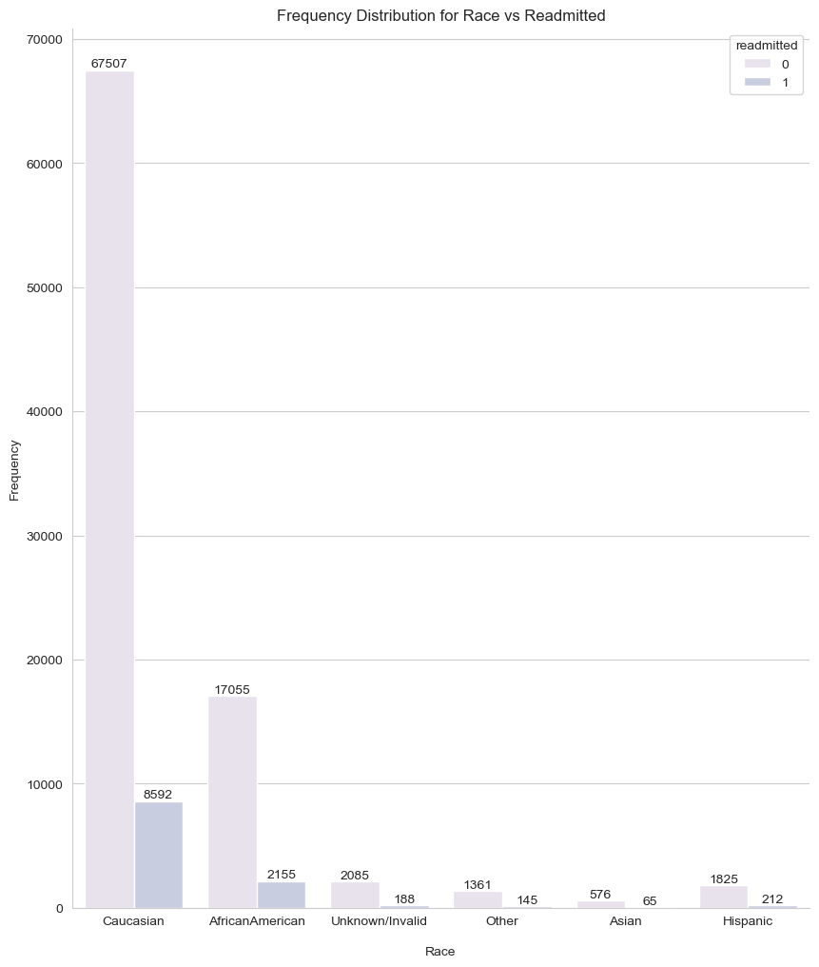
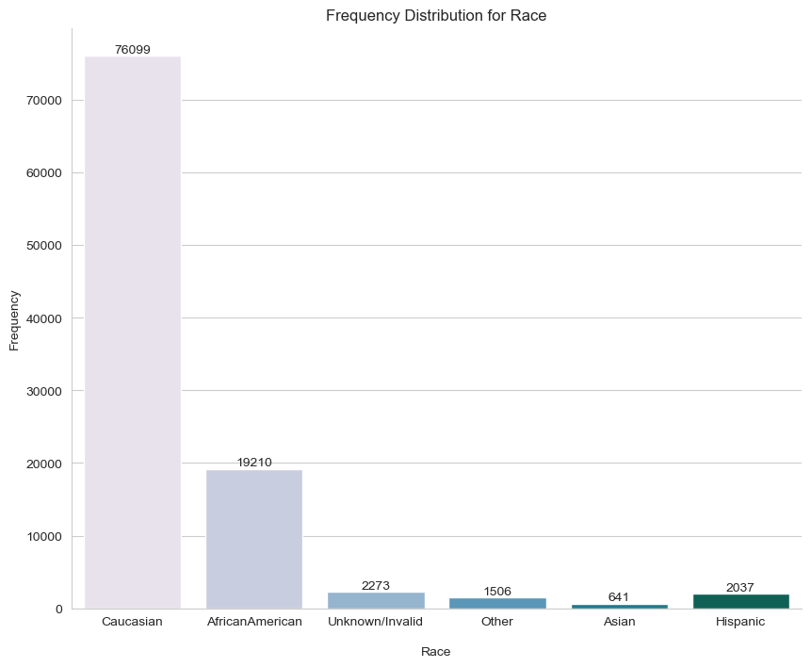
Exploring Race Feature
The count plots for “race” clearly represent that most patients are Caucasian which is nearly 75% or three-fourths of all the data. This is because the population of United States is dominated by Caucasians. There are Unknown/Invalid values which will be dropped as they are only a small percentage of all values.

Slide 10
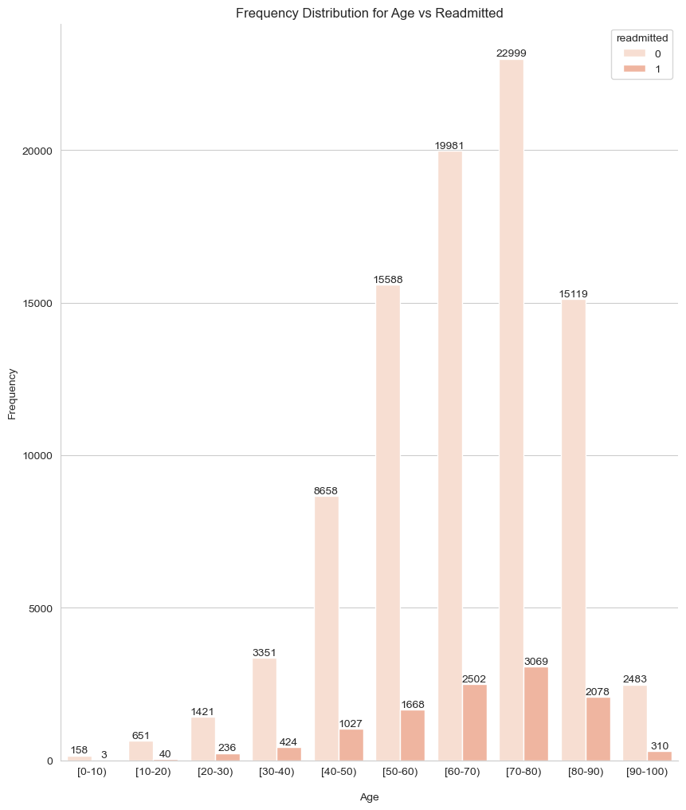
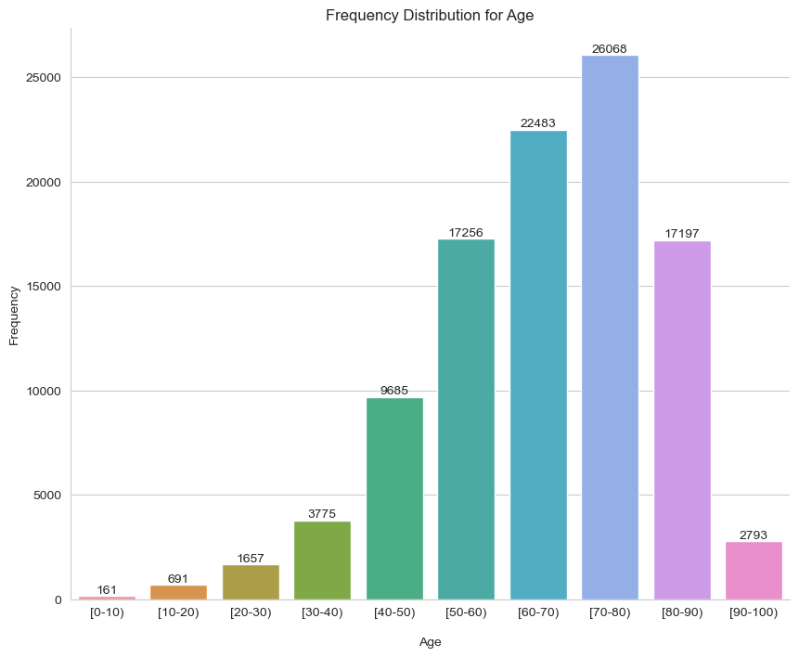
Exploring Age Feature
While looking at the count plots for `age` column, one insight that can be drawn is that a lot of the patients are of older age. This is in line with the fact that people in old age tend to experience diabetes as compared to people younger than them. This is true for readmission of patients as well. The patients readmitted the most are of older age group.

Slide 11
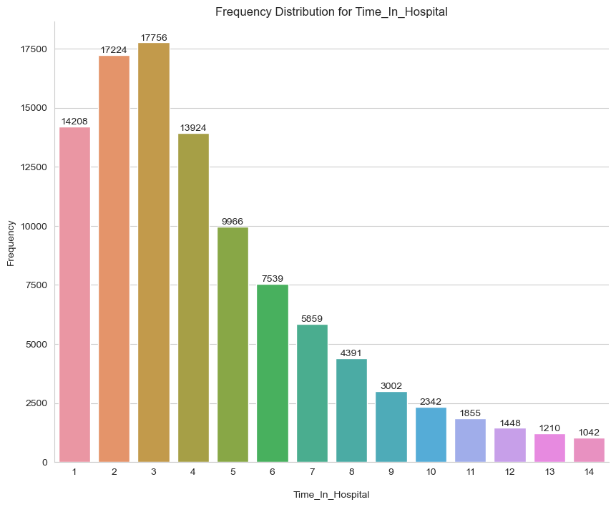
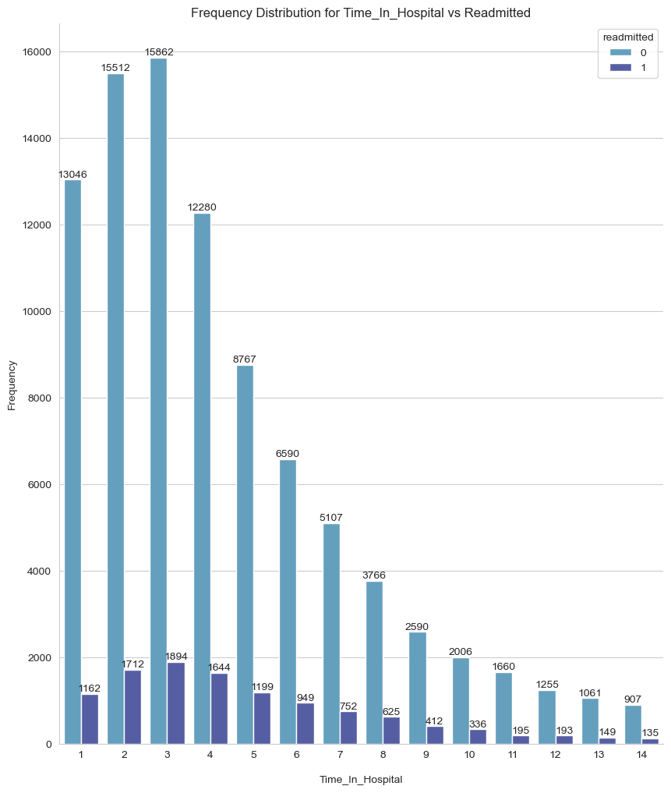
Exploring Time in Hospital Feature
By looking at the plots for `time_in_hospital` feature, we can conclude that a lot of people spent 1-4 days in the hospital. This is because hospitals need to do primary, secondary and third level of diagnoses and need to perform a lot of lab tests. Thus, patients are admitted in the hospital for multiple days. Also, it is not common for diabetic patients to spend more than 10 days until and unless something is serious.

Slide 12
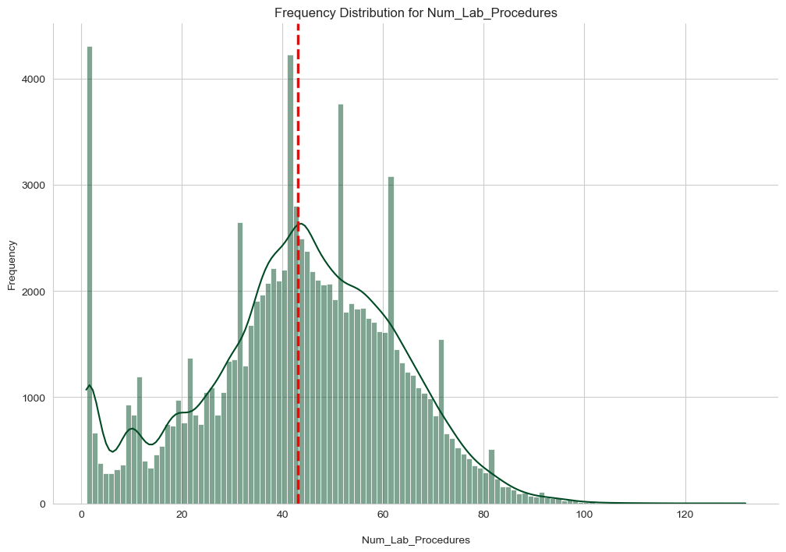
Histogram for Number of Lab Procedures
Looking at the histogram, we can see that on average around 43 lab procedures are conducted during each encounter. Since, there are more than 40 procedures conducted on average, the length of stay in hospital will also be more.

Slide 13
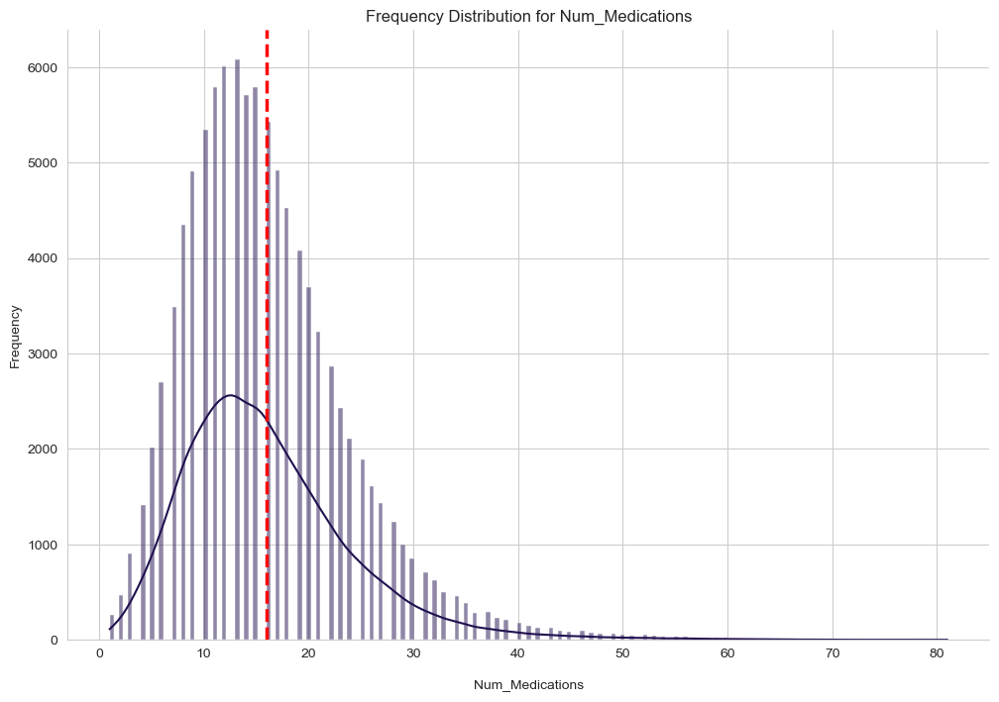
Histogram for Number of Medications
Looking at the histogram, we can see that on average, around 16 medications are given to the patient during each encounter.

Slide 14
Data Preprocessing and Feature Engineering
Data Cleaning
Data Mapping
Feature Engineering
Oversampling the minority class using SMOTENC
Encoding categorical columns
Normalizing numerical columns using MinMaxScaler

Slide 15
Data Cleaning
The attributes such as “encounter_id” which represent an identifier or have a lot of unique values have been dropped.
Dirty and garbage values such as ‘?’ have been replaced with NaN values and the columns which have more than 25% missing values have been dropped altogether.
If a column has very small percentage of missing values, then those rows have also been dropped.

Slide 16
Data Mapping
The attributes “admission_type_id”, “discharge_disposition_id” and “admission_source_id” have a lot of unique IDs which correspond to some description. But a lot of the descriptions have the same meaning across different IDs. So, IDs have been grouped together to signify the same meaning and reduce the dimensionality of the data.
For the attributes “diag_1”, “diag_2” and “diag_3”, there are standard ICD-9 codes which represent the official system of assigning codes to diagnoses and procedures associated with hospital utilization in the United States. These have also been clubbed together to represent their corresponding chapters according to the range of their values. This mapping process also leads to a reduction in dimensionality.

Slide 17
Feature Engineering
There are around 23 features in the dataset that measure the dosage changes in diabetes medications. All these 23 features represent diabetes medication. The values are “Down” (dosage was decreased), “Up” (dosage was increased), “Steady” (no change in dosage) and “No” (medication was not prescribed).
I have created a new feature named “number_of_dosage_changes” that tracks the number of dosage changes across these 23 features. This is a numerical feature which will group all the information into one attribute. This will decrease the number of features in the dataset which might help in overcoming overfitting.
Another feature has been created named “Number of Total Visits” which sums up the number of inpatient visits, number of emergency visits and number of outpatient visits for that patient in the previous year.

Slide 18
Oversampling the minority class using SMOTENC
We saw in EDA that the dataset has imbalanced classes with majority being the negative class and the minority being the positive class. Thus, for the model to perform better, we need to oversample the minority class in the training data. The oversampling should not be done on validation and test data.
The oversampling is done using SMOTENC function which comes from the imbalanced-learn package.
Oversampling leads to a 50-50 split for the “readmitted” class label in training data.

Slide 19
Encoding Categorical columns
All the categorical columns are nominal columns which have been encoded using OneHotEncoder function from sklearn library.
The “readmitted” column (class label) has also been encoded using “0” to represent the negative class (no readmission + readmission after 30 days) and “1” to represent the positive class (readmission within 30 days).

Slide 20
Normalizing Numerical Columns
All the numerical columns in the dataset along with the new features created must be normalized to bring them into same range of values.
If features are not normalized, different features with different scales might contribute unequally to model fitting.
The features are normalized using MinMaxScaler function from sklearn library which transforms all the numerical features to a [0, 1] range.

Slide 21
Building Baseline Models
Split the training, validation and test data to X_{data} and y_{data}.
Fit the baseline Logistic Regression, Random Forest and XGBoost classification models on training data.
The metric used for measuring model performance is “Recall”. This is because we don't want to miss out labelling patients as being readmitted when they will be readmitted, i.e., we want to decrease the “False Negatives” in our prediction.
The models are fit on validation data only and the test data is held out for final evaluations.
Observations : Logistic Regression performs the best out of the 3 baseline models while Random Forest heavily overfits the data.

Slide 22
Feature Selection and Model Fitting
At this point, there are a lot of features in the dataset which is why the models are overfitting. To decrease overfitting, I performed feature selection and computed the feature importance using Random Forest and picked the top 11 features and fit the models again on training data but with only these 11 features.
Observations: After performing feature selection, the overall overfitting decreased, and the recall increased for all 3 models. But the best performing model was still Logistic Regression. Additionally, the number of False Negatives decreased after feature selection which improved the performance of the model.

Slide 23
Hyperparameter Tuning
Hyperparameter tuning for all 3 models done using GridSearchCV function in sklearn library.
Observations: The recall improved by only a small percentage value for all 3 models. Logistic Regression still performed the best across all 3 models and there was a decrease in False Negatives after hyperparameter tuning.
The best performing model was : LogisticRegression(C=10, class_weight='balanced', max_iter=1000, random_state=633)

Slide 24
Final Evaluations
The best Logistic Regression model as shown in the previous slide is used to test the model on the held-out test data.
The recall score for this model is 34.2% on test data.
One way to improve the recall is to reduce the threshold. By default, the threshold for probabilistic models in sklearn are set to 0.5.
By decreasing the threshold, we take a conservative approach and classify more people belonging to the positive class.

Slide 25
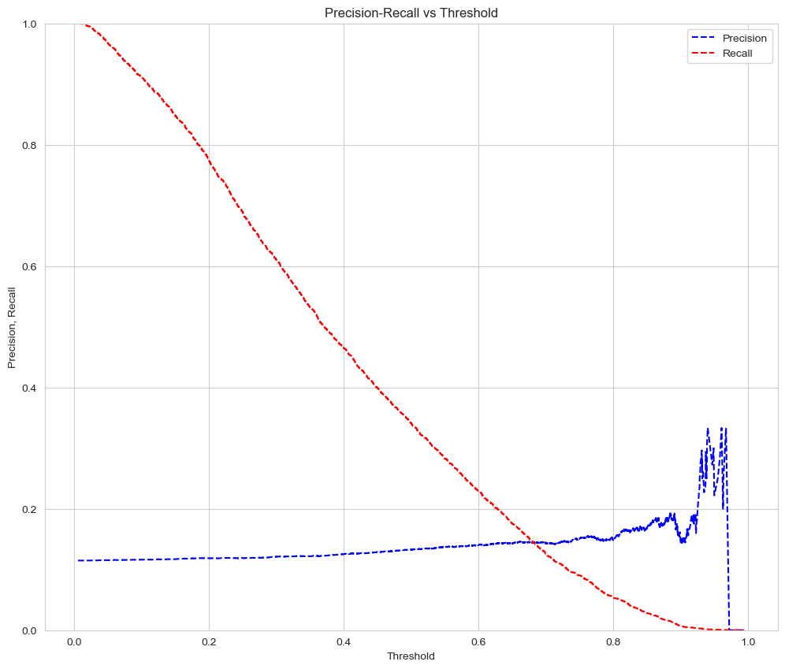
Precision-Recall vs Threshold
From the graph, we can see that a threshold of ~0.2 would increase the recall a lot as compared to the default threshold of 0.5. At threshold = 0.2, the precision is approximately equal to the value at threshold = 0.5. So, we will create new predictions and classify all samples which have probability > 0.2 as being readmitted to hospital within 30 days.

Slide 26
Final Evaluations (contd.)
Since, we are concerned with predicting readmission of a patient, we don’t want to miss out on patients that were readmitted, and our model predicted as not readmitted. Hence, we can handle a lower precision score but to increase recall, I decreased the threshold to 0.2.
Thus, all predictions on test data with probabilities greater than 0.2 will be declared as being readmitted and others will be declared as not being readmitted.
This leads to an increase in recall from 34.2% to 77.5%.
The False Negatives also decrease from 1820 at threshold = 0.5 to 622 at threshold = 0.2.

Slide 27
Conclusion
Across all three models, Logistic Regression performed best in terms of recall. Recall is the chose evaluation metric because we want as low False Negatives as possible. The best model performance is at threshold value 0.2. In practice, the decision making for choosing the best evaluation metric and threshold are done by subject matter experts and we would keep updating the model after internal discussions. But, since this is a course project, this would be the final model for the given problem statement.

Slide 28
Thank you
Hemant Rattey
hr5259@g.rit.edu

